Slide 1
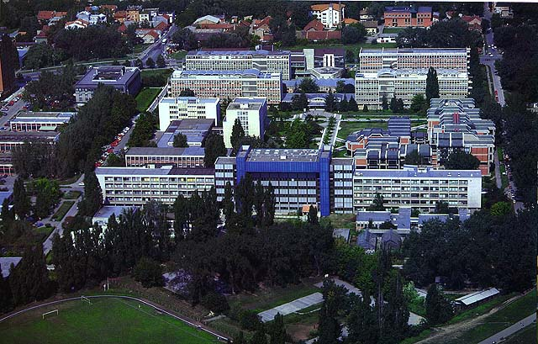
UNIVERSITY OF NOVI SAD
www.uns.ac.rs

Slide 2
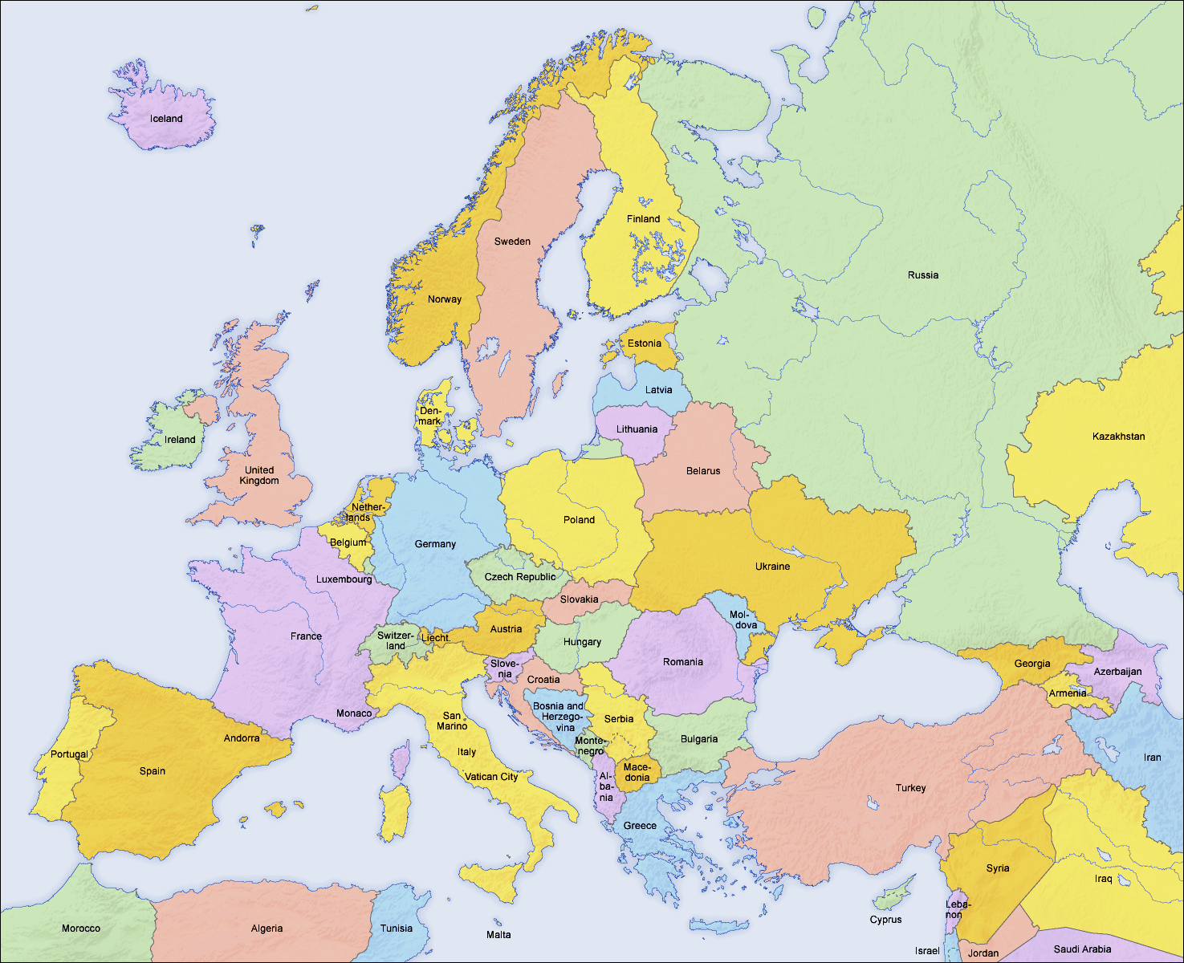
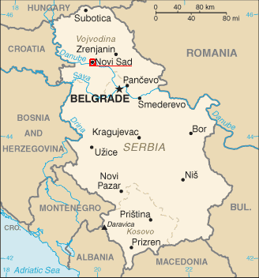
Serbia – Vojvodina – Novi Sad
UNIVERSITY OF NOVI SAD

Slide 3
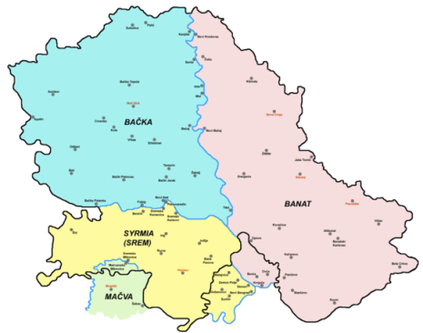
Serbia – Vojvodina – Novi Sad
Autonomous Province of Vojvodina (APV)
3 parts (Bačka, Banat and Srem)
6 official languages
27 nations and cultures
cca. 2 000 000 inhabitants
Name means “duchy” or voivodeship
UNIVERSITY OF NOVI SAD

Slide 4
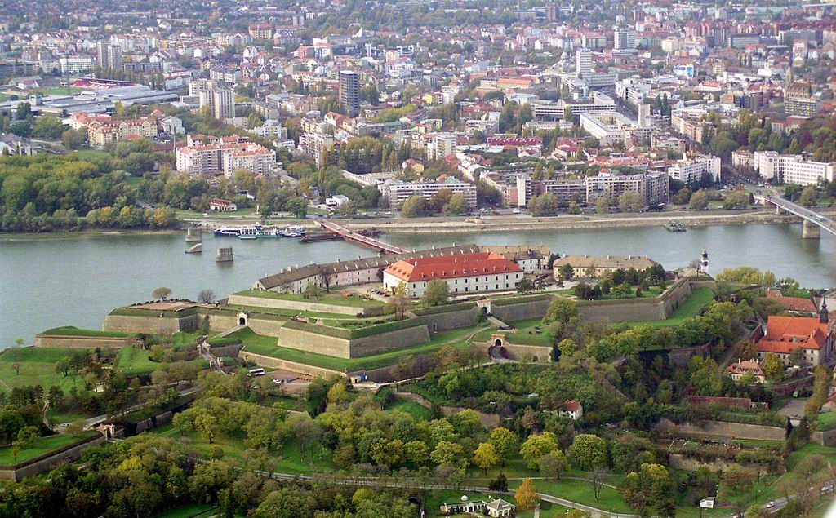
Serbia – Vojvodina – Novi Sad
Administrative center of APV
350 000 inhabitants (400 000 with surrounding area)
On the Danube river
Status of the “free royal city” in 1748
Industry: agriculture-oriented, metal and rising IT-sector
UNIVERSITY OF NOVI SAD

Slide 5
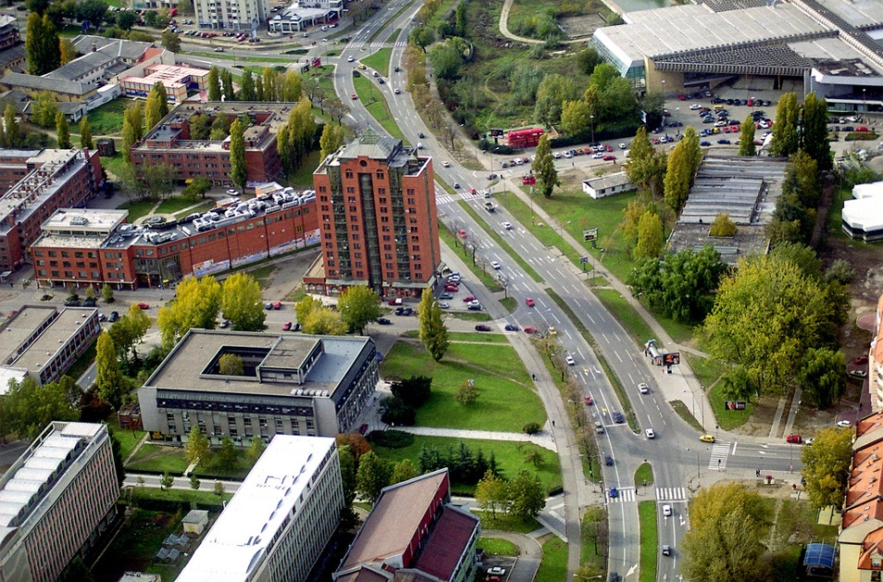
University of Novi Sad
- Facts and figures -
Founded in 1960
First faculties in 1954 (with some
forms of higher education
dating back to XIX century)
The only state university in APV
(7 state universities in Serbia)
More than 50 000 students
283 study programs (3 cycles)
Comprehensive university
5000 staff members
Central campus (260 000m²)
Not fully integrated (faculties are
legal entities)
UNIVERSITY OF NOVI SAD

Slide 6
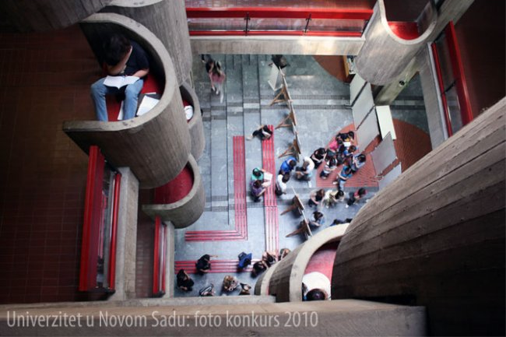
University of Novi Sad
- Organisation -
FACULTIES
Faculty of Philosophy
Faculty of Agriculture
Faculty of Law
Faculty of Technology
Faculty of Technical Sciences
Faculty of Medicine
Faculty of Sciences
Academy of Arts
Faculty of Sport and Physical Education
Faculty of Economics in Subotica
Faculty of Civil Engineering in Subotica
Teachers' Training Faculty in Hungarian in Subotica
"Mihajlo Pupin" Technical Faculty in Zrenjanin
Faculty of Education in Sombor
Institute of Lowland Forestry and Environment
Institute of Food Technology
UNIVERSITY OF NOVI SAD

Slide 7
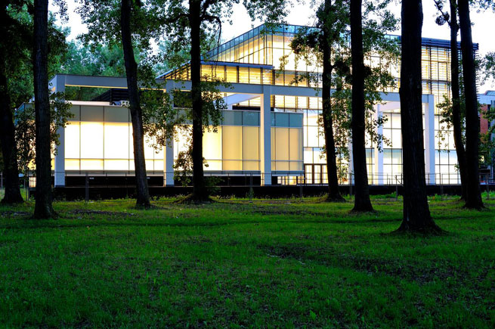
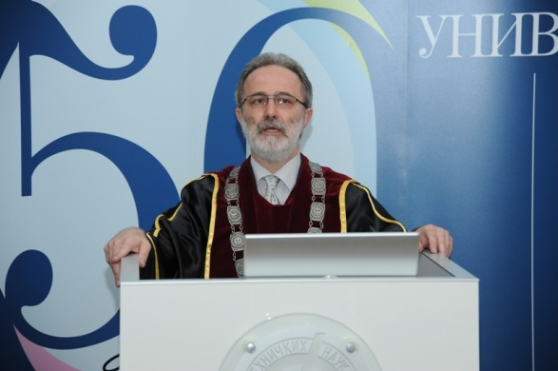
University of Novi Sad
- Leadership -
Rector
Prof. Dr. Miroslav Vesković
Vice Rectors
Prof. Dr. Pavle Sekeruš, Science,
Arts and International Cooperation
Prof. Dr. Zita Bošnjak, Education
Prof. Dr. Radovan Pejanović, Finance
UNIVERSITY OF NOVI SAD

Slide 8
University of Novi Sad
- International Relations -
More than 65 bilateral agreements
Active participants in TEMPUS, FP7, IPA, COST, DAAD...
Mobility programs ERASMUS MUNDUS, Campus Europae, CEEPUS...
International Relations Office (IRO)
Ivana Vujkov, Head of Office
Dubravka Gavrančić
Milan Vurdelja
Miloš Milutinović
Ivana Đokvučić (KBF staff)
Office email: iro@uns.ac.rs
FACEBOOK: Mobility Novi Sad
Project Management Office (PMO)
Ana Šoti
Vesna Mašulović
Nemanja Mišković
Dunja Malbaša
Office email: projekti@uns.ac.rs
UNIVERSITY OF NOVI SAD

Slide 9
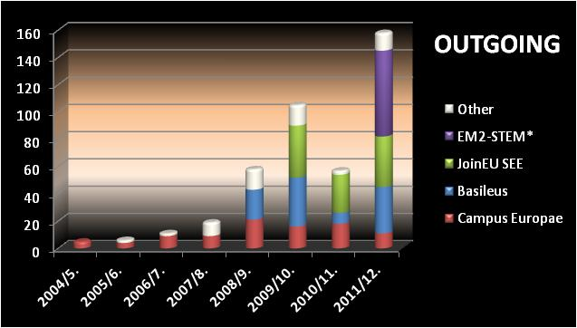
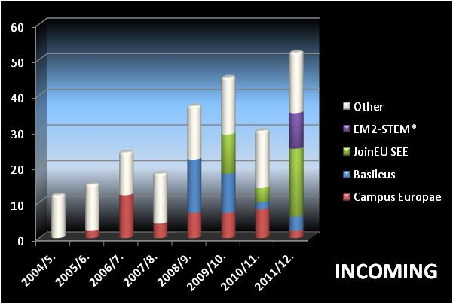
ACTIVE IN ERASMUS MUNDUS ACTION 2:
2011/12: 155 outgoing and 55 incoming
University of Novi Sad
- Student mobility -
UNIVERSITY OF NOVI SAD

Slide 10
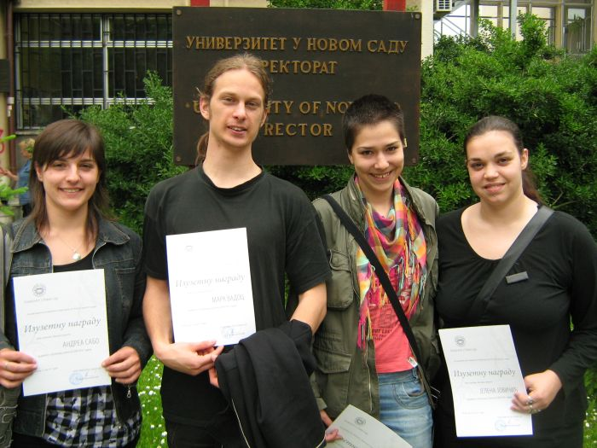
University of Novi Sad
- Incoming mobility -
Mobility programs
Bilateral agreements 65
Campus Europae
Ministry of Education Scholarships
ERASMUS MUNDUS (action 2)
Basileus IV
JoinEU-SEE IV
SIGMA
Countries: Austria, Czech Republic, France, Germany, Italy, Latvia, Lithuania, Poland, Romania, Slovenia, Spain...
UNIVERSITY OF NOVI SAD

Slide 11
University of Novi Sad
Research and projects
TEMPUS
Ongoing: 36, Coordinating: 6
FP7 Ongoing: 24
COST, IPA, NATO, SCOPES, BILATERAL PROJECTS,
DOMESTIC PROJECTS, EUREKA
More than 150 national projects and
numerous projects with the industry
UNIVERSITY OF NOVI SAD

Slide 12
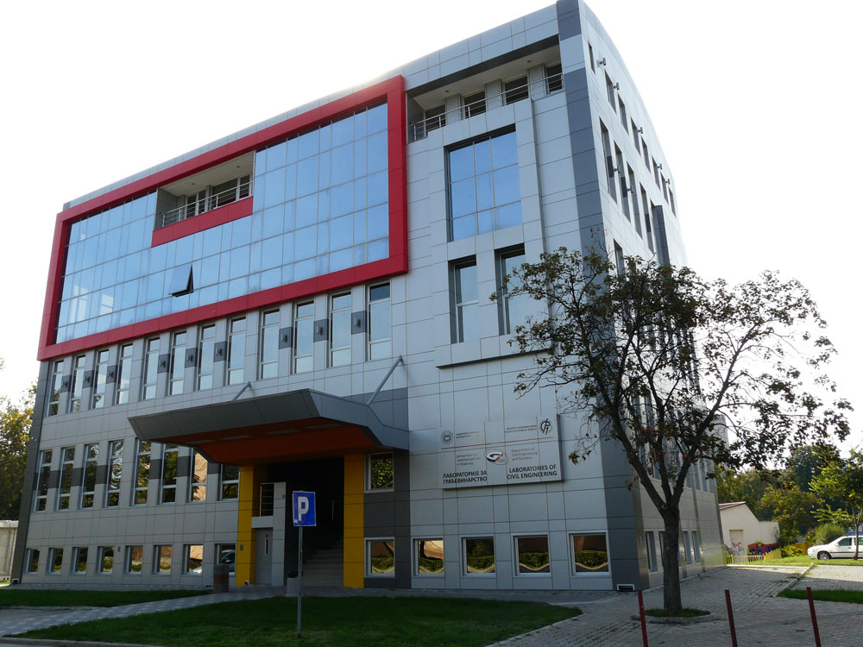
University of Novi Sad
Science and Technology park
Phase I and II, over 20 mil. EUROS
UNIVERSITY OF NOVI SAD

Slide 13
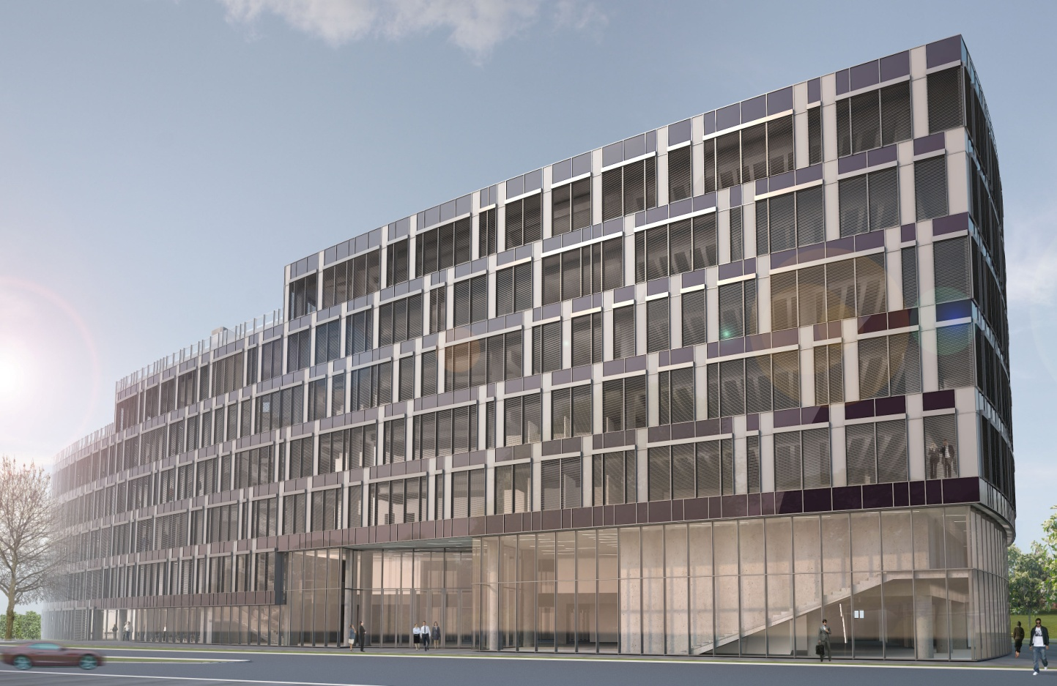
University of Novi Sad
Science and Technology park
Phase II
UNIVERSITY OF NOVI SAD

Slide 14
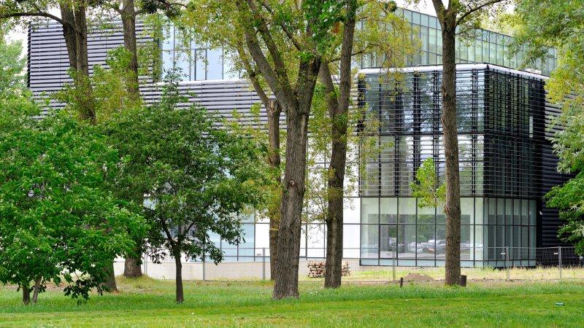
Central University Building
6900m2, 6 mil. EUR
Amphitheatre, lecture halls,
University Club,
Central Library,
Student parliament,
Central university services,
Rector’s Office…
University of Novi Sad
UNIVERSITY OF NOVI SAD

Slide 15
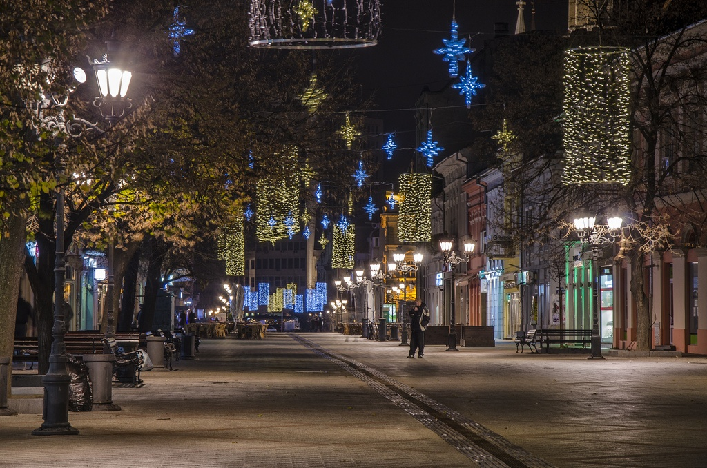
THANK YOU!
UNIVERSITY OF NOVI SAD

