Slide 2
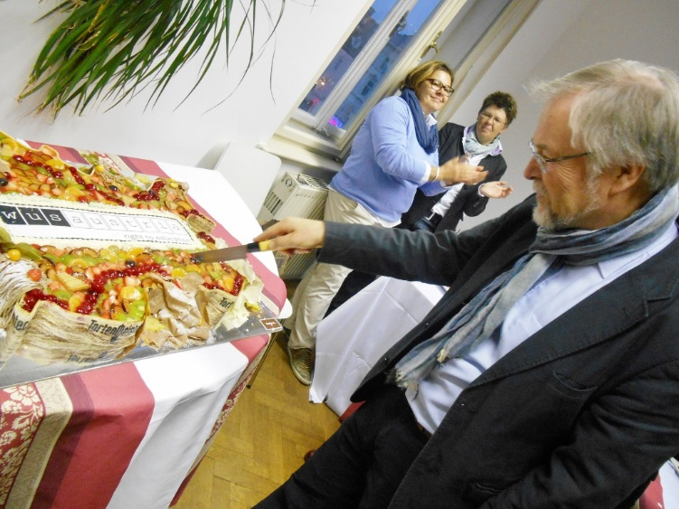
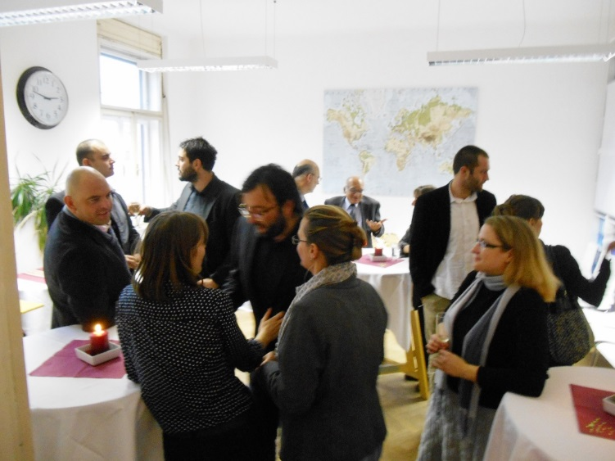
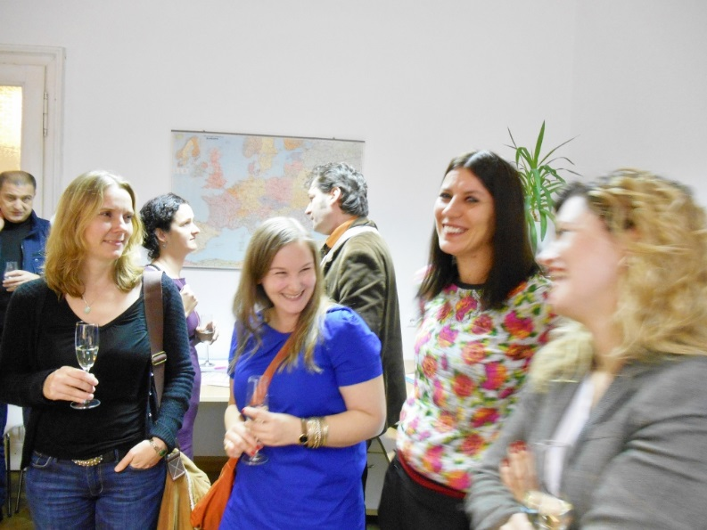
We celebrated our
30th anniversary in 2013
.

Slide 3
COMPETENCIES
30 years of experience/expertise in and knowledge of:
Higher education development and reform;
Technology transfer and in the development of R&D and innovation policies, strategies and structures;
Change processes at higher education institutions in transition countries;
Strategic development, capacity and institution building;
Global trends and developments in higher education;
Coordination, management, preparation, implementation, monitoring and internal evaluation of projects in higher education;
Political, economic, social and educational situation in South-Eastern Europe;
Working in an international and intercultural context;
...and the ability to use all this experience and expertise for the successful implementation of measures for specific target groups.

Slide 4
APPROACH
Shaping change processes through capacity building and trainings – we develop modules for higher education institutions in an international context and provide knowledge and tools to manage the challenges;
Diversified and tailor-made approach for each individual region, country and institution;
Holistic approach where all stakeholders at all levels are part of the process and where the interests of staff and students are equally taken seriously as are the views and opinions of university management and political stakeholders;
Equal opportunities - we constantly ensure that all training services and capacity building activities are open to both women and men, and encourage people of all ages to participate in our projects as experts as we highly appreciate the advantages of a differentiated and balanced working team.

Slide 5
SERVICES (expertise)
Our services are divided in the following areas:
Higher Education Development
Curriculum Development
Change Management and Organizational Development
External and Internal Quality Assurance
Internationalization and Mobility
Linking Higher Education, Industry & Society
Structural Instruments for Innovation, Research & Development
Practice-oriented Education
Lifelong-Learning (LLL)
Higher Education & Human Rights

Slide 6
SERVICES
We furthermore provide TECHNICAL SUPPORT as an integrative part with the following services:
Technical Support
Project Management
Fundraising and Management of Project Applications
Event Management
Trainings

Slide 7
THE INTERNATIONAL CHARACTER OF OUR ACTIVITIES
approx. 30 ongoing projects
more than 120 finalized projects
we work with partners from over 50 different countries
we are part of a larger network of WUS committees “WUS International”, the “European student relief” action was founded in Vienna in 1920 and network will celebrate its 100th years anniversary in 2020.

Slide 8
Where we work
WUS Austria implements projects mainly in South- Eastern Europe, but has expanded its geographical coverage also to other areas of the world. Currently WUS Austria implements projects in Europe, Asia and Northern Africa.
List of countries:
Albania Algeria Armenia Azerbaijan Belarus BiH China Croatia Czech Republic Georgia Hungary Kazakhstan Kosovo Kyrgyzstan |  | Macedonia Mexico Moldova Montenegro Namibia Poland Romania Russia Serbia Slovakia Slovenia Tajikistan Ukraine

Slide 9
Ongoing projects (I)
ARARAT - Armenian Coordination Agency "University -Employer"
Children’s University in Bosnia and Herzegovina
Competence@University of Prishtina
Construction of a new Medical Preclinic Campus in Banja Luka, Phase I, concept
DELLCO - Development of the Lifelong Learning Concept at the University of Montenegro
EQADE - Embedding Quality Assurance in Doctoral Education
Higher KOS - Promoting Institutional Development in Higher Education and Research in Kosovo
INARM – Informatics and Management: Bologna-Style Qualifications Frameworks
INSETT_ Improving the Quality of In-Service Teacher Training System
INTERFACE
KIKT – Kosovo Interdisciplinary Knowledge Triangle Center – PhD based Education, Research and Training for Medical and Natural Sciences
One Month Visits to Austria
PATTERNS_Lectures

Slide 10
Ongoing projects (II)
PhD in Food Science & Technology & Creating Capacities for PhD Reform at the University of Pristina/Kosovo
QA@UPPZ - Strategic Support for the development of Sustainable QA Structures at the Newly Public Founded University in Kosova, University of Prizren
QinR - Quality in Research
QUADRIGA: Qualification Frameworks in Central Asia: Bologna-Based Principles and Regional Cooperation
QUAEM - Development of Quality Assurance in Higher Education in Moldova
REGENLAW - Development of Regional Interdisciplinary Postgraduate Energy and Environmental Studies
SHEQA - Strategic Management of Higher Education Institutions Based on Integrated Quality Assurance System
Support to Higher Education and Scientific Research in Algeria
Teachers: Agents of change. A strategic approach to anchoring development education in Czech and in Polish formal education systems
UNAM - Promoting the Modernization and Strengthening of Institutional and Financial Autonomy in Southern Neighbouring Area Higher Education Institutions
UNIMIG - Migration and Higher Education - Building Skills and Capacities

Slide 11
New projects (starting 2014)
DEVCORE
GOVERN
iDEA lab
KTU
MAIN
ONEHEALTH
PICASA
SIPUS
UNIQE
VERITAS

Slide 12
www.wus-austria.org

