Slide 1
Ghent University

Slide 2
Overview
Our location
A long history
Organisational structure
Education
Research
Facts & Figures
Internationalisation

Slide 3
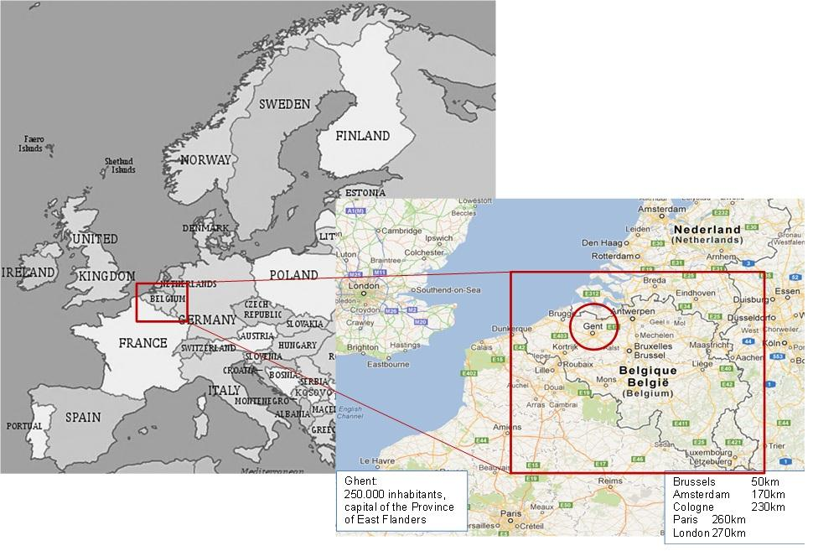
Our Location

Slide 4
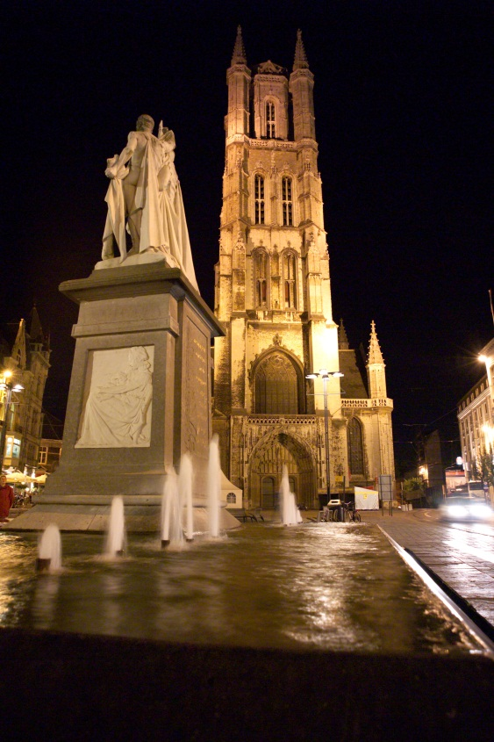
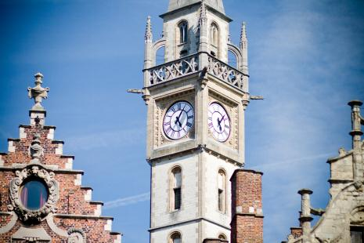
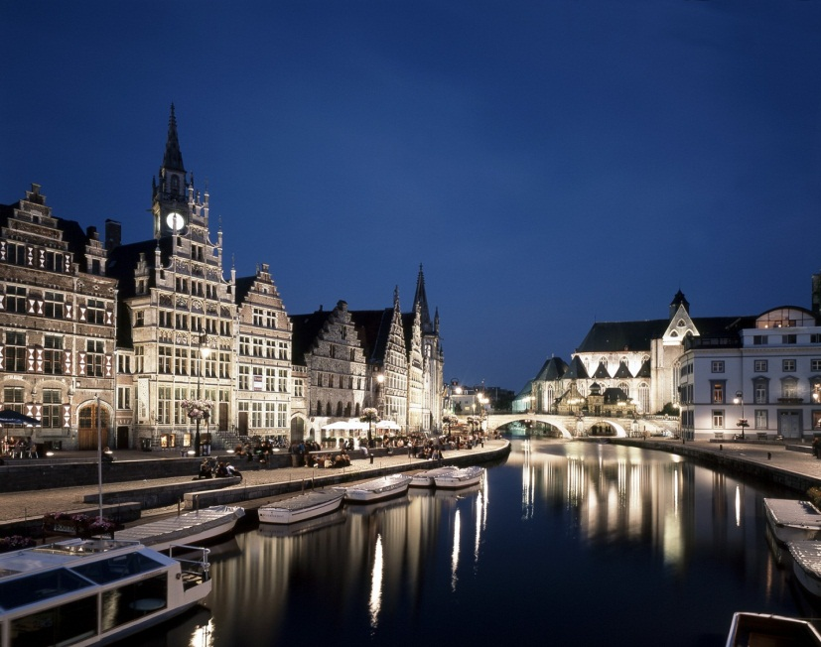
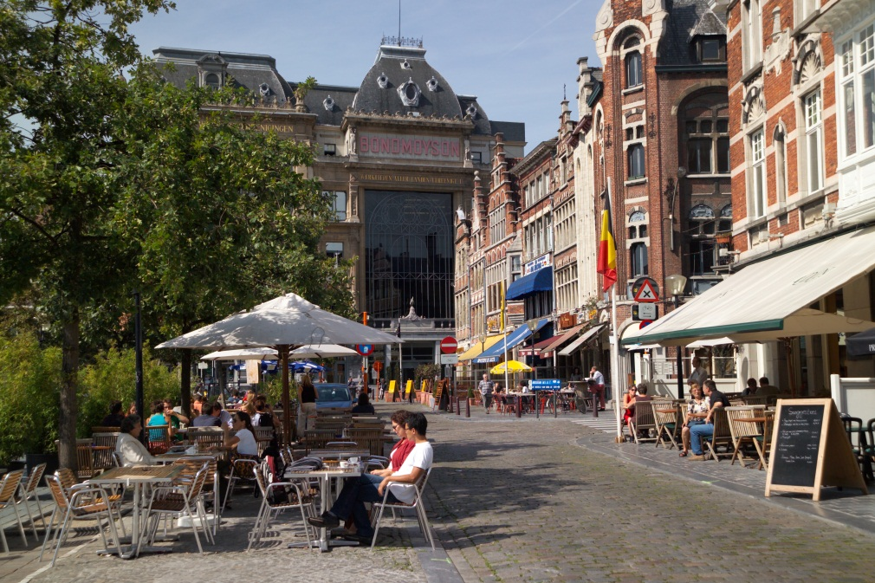
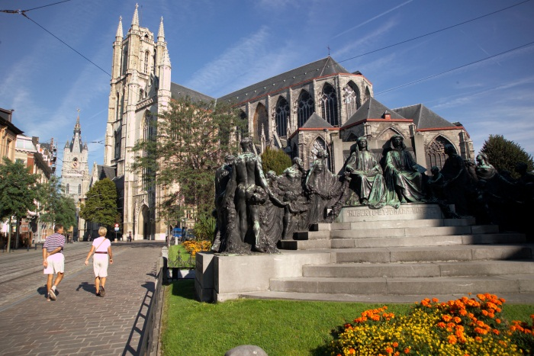
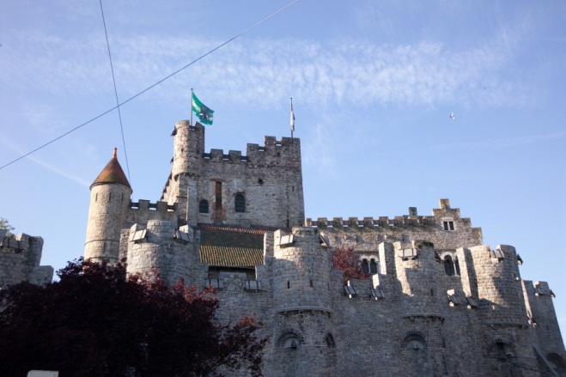
Our location > City of Ghent

Slide 5
A long history
1817
Ghent University is founded by the Dutch king Willem I (United Kingdom of the Netherlands)
1830
Belgian independence - “Belgian State University” - French becomes the language of tuition
1882
First female student
1930
The official language of tuition is changed to Dutch
1938
Nobel prize for Prof Corneel Heymans
1991
Larger autonomy for the University - State University Ghent becomes Ghent University

Slide 6
2013: new milestones in university history
Prof. Anne De Paepe elected as first female Vice-Chancellor
Integration of academic programmes university colleges
+ 40 programmes (BA, MA)
+ 6800 students
+ 600 staff members
+ Campus in Kortrijk

Slide 7
Organisational structure
Board of Governors
↓ Executive Board
↓
Management Board
8 Central Departments
11 Faculties
Educational Affairs
Research Affairs
Administrative Affairs
Personnel and Organization
Financial Department
Information and Communication Technology
Infrastructure and Facility Management
Student Facilities
Arts and Philosophy
Law
Sciences
Medicine and Health Sciences
Engineering and Architecture
Economics and Business Administration
Veterinary Medicine
Psychology and Educational Sciences
Bioscience Engineering
Pharmaceutical Sciences
Political and Social Sciences

Slide 8
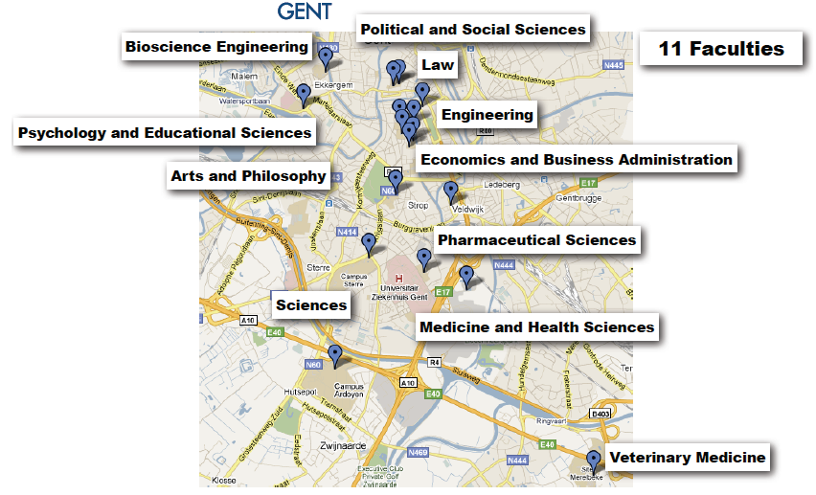
Organisational structure > Faculties
11 faculties - 125 departments

Slide 9
Education
Comprehensive university
81 BA programmes
140 MA programmes and Advanced MA programmes
Research based top quality education
Dutch speaking university
English is widely spoken by students and staff
Many separate courses taught in English
40 English taught MA programmes
www.UGent.be/coursecatalogue

Slide 10
Research
Doctoral schools
Organization
Doctoral School of Arts, Humanities and Law
Doctoral School of (Bioscience) Engineering
Doctoral School of Life Sciences and Medicine
Doctoral School of Natural Sciences
Doctoral School of Social and Behavioural Sciences
Spearheads
Multidisciplinary Research Partnerships
Biotechnology for a sustainable economy (Ghent Bio-Economy)
Bio-Informatics (From Nucleotides to Networks)
Nano- and Biophotonics (Center for Nano- and Biophotonics)
Neurosciences (Institute for Neuroscience)
Inflammation and Immunity (GROUP-ID)

Slide 11
Facts & Figures
Students 2013-2014
Total population 41.192
International students 10% → over 4.000
PhD students 3.800 (Dec. 2012)
International PhD students 30% → over 1.000
Staff (Jan. 2014)
8.529 staff members (excl. Ghent University Hospital: over 6.000)

Slide 12
Facts & Figures > Students per faculty

Slide 13
Facts & Figures > Incoming exchange

Slide 14
Facts & Figures > Outgoing exchange

Slide 15
Facts & Figures > Research output

Slide 16
Facts & Figures > Staff
8,529 Staff Members
Professors: 1.372
Assistant academic staff: 1.399
Researchers: 3.074
Administrative & Technical Staff: 2.684

Slide 17
Facts & Figures > Rankings
Shanghai Ranking – August 2013
World rank: 85
National rank: 1
THE Ranking – October 2013
World rank: 85
National rank: 2
Notes:
Shanghai Ranking - Measuring research performance such as: Highly cited researchers; Papers indexed in major citation indices; Per capita academic performance
THE - World University Ranking by Times Higher Education: Judgement across Teaching; Research; Knowledge transfer; International outlook

Slide 18
Internationalisation
Wide variety of programmes: externally funded and own initiatives
Tradition in internationalisation
ECTS label (2004-2009, 2009-2013, 2013-2016)
Erasmus success story
Very active in Tempus
9 Erasmus Mundus Action 1 Joint Masters (2 as coordinator) and 2 Doctoral Programmes as coordinator
32 EM Action 2 projects (11 coordinated by UGent): 5 Basileus projects in the Western Balkans www.basileus.ugent.be
Stress on development cooperation
Several prestigious ERC grants
Bilateral agreements with non-EU partners, own funding

Slide 19
Internationalisation > Strategy
Integrated institutional strategy for internationalisation 2014-2018*
Internal structure and communication
Strategic cooperation
Quality driven
Regional focus
Internationalisation of education
25% outbound student mobility
English taught courses
Internationalisation@Home
Selective recruitment of students and staff
Orientation programme
Focus on integration
International branding
* To be approved by University board and management

Slide 20
Internationalisation > Platforms
Africa Platform
China Platform
Partnership between Ghent University, Province of East-Flanders, City of Ghent, Ghent harbor and Flanders-Chinese Chamber of Commerce
Beijing representative office
India Platform

Slide 21
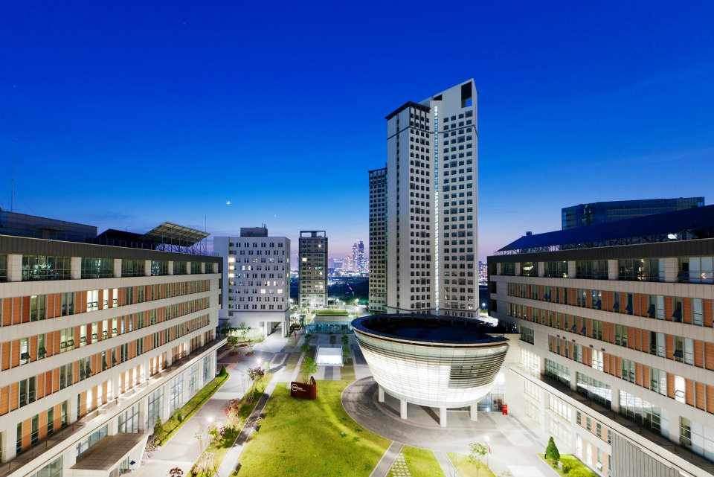
Internationalisation > Branch campus
Songdo Branch Campus South-Korea
Incheon Free Economic Zone
Incheon University
Programmes BA and MA level
Biotechnology
Environmental Technology
Food technology

Slide 22
Internationalisation > Networks and Alliances
Ghent University Association
Santander Group
Regional Alliances
U4 network (Gent, Göttingen, Groningen, Uppsala)
Kent (UK)
Lille (France)
Missouri – Western Cape
Global Initiatives Partnership
EUniverCities

Slide 23
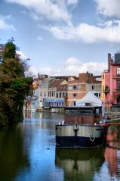
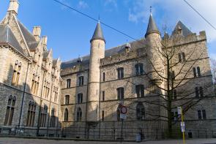
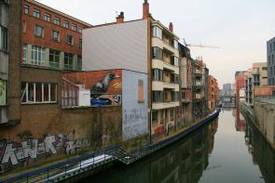
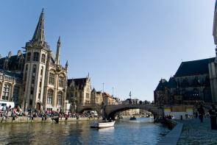
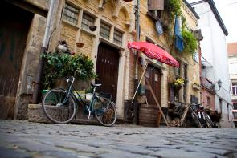
Contact
Ghent University
Sint-Pietersnieuwstraat 25
B - 9000 Ghent
IRO@UGent.be
www.UGent.be/en
www.twitter.com/UGentIRO

